Slide 1
Docker and Kubernetes
Network Overview
QD Open BGW
Chason Du <chason.du@nokia-sbell.com>
Sep 13, 2017

Slide 2
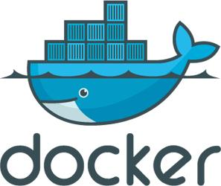
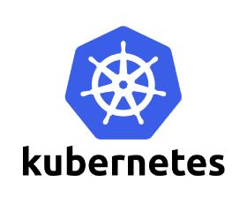
Content
Docker Network Overview
Bridge
Host/other container/none
Docker Multi-host Network
Kubernetes Network: Flannel
Others:
Static routing
Pipework
Open Vswitch
Weave
Calico
Docker 1.9 libnetwork
Performance Test and Compare
Appendix: bridge, veth pair, TUN/TAP, iptables/netfilter

Slide 3
K8S, Docker, Container
The relation between K8S and Docker is same with Openstack and KVM(Hypervisor)
K8S, google, 2014, Google Container Engine
Kubernetes is a newly released Google’s Container-as-a-Service solution.
Kubernetes builds upon 15 years of experience of running production workloads at Google
Kubernetes could potentially be seen as a substitute for Openstack in providing docker based container scheduling and deployment.
Kubernetes can be used on top of Openstack.
Docker, March 2013
Openstack open-source community is currently working with the Docker team for providing a driver than can seamlessly be loaded into Openstack for providing a container-as-a-service solution orchestrated by openstack nova itself.
Docker and Linux Container
Notes:
https://www.symantec.com/connect/blogs/google-kubernetes-analytical-evaluation

Slide 4
Docker Network Overview
These three networks are built into Docker. When you run a container, you can use the --network flag to specify which networks your container should connect to.
# docker network ls
NETWORK ID NAME DRIVER SCOPE
23562d1e0005 bridge bridge local
ca5d43ef7fe5 host host local
b0572eb45098 none null local

Slide 5
Docker Network: bridge mode
Docker host: 10.13.245.198:32768
-net=bridge, default network mode
Docker0, veth pair
Network namespace and private network. (RFC1918 or --bip=10.255.95.1/24)
Docker0 IP is the default gw of container
New route rule for host accessing
New iptables rule for publish port
Container: bridge mode
lo
veth pair
vethxxx
eth0
10.255.95.10:80
docker0
# brctl show
# ifconfig docker0 vethxxx
# cat /proc/sys/net/ipv4/ip_forward
# route -n
# iptables -t filter –S/iptables –t nat -S
# lsof -i :32768
# docker network inspect bridge
10.255.95.1
iptables
eth0
Notes:
http://dockone.io/article/1521

Slide 6
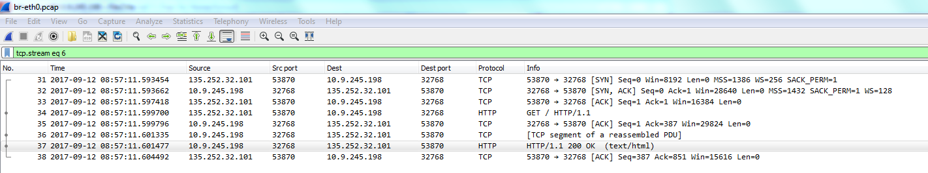
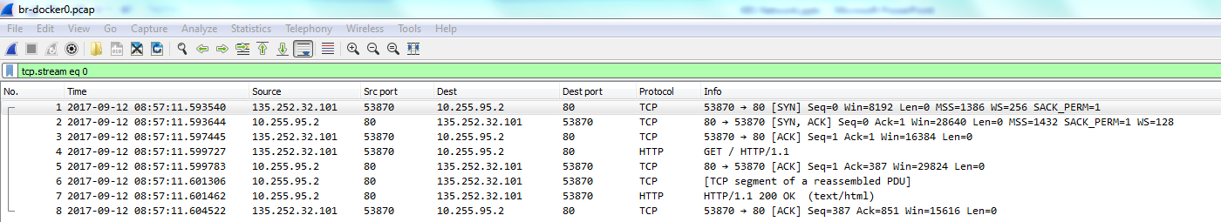
Bridge Mode Example Nginx publics port to host
# lsof -i :32768
docker-proxy -proto tcp -host-ip 0.0.0.0 -host-port 32768 -container-ip 10.255.95.10 -container-port 80
# docker run -d -p 32768:80 --net=bridge --name br-demo nginx
# tcpdump -i eth0 -w br-eth0.pcap
# tcpdump -i docker0 -w br-docker0.pcap
Notes:
http://dockone.io/article/1521

Slide 7
Bridge Mode Example Nginx publics port to host
eth0
DNAT: 10.9.245.198.32768→10.255.92.2:80
docker0
Nat: DNAT
PREROUTING
Nat: Accept
FORWARD
Filter: Accept
Nat: Accept
POSTROUTING
Nat: SNAT
docker0
eth0
SNAT: 10.255.95.2:80→10.9.245.198.32768
# iptables -t nat -S
# [DNAT] all traffic incoming to port 32768 dnat to 10.255.95.10:80(container IP)
-A PREROUTING -m addrtype --dst-type LOCAL -j DOCKER
-A DOCKER ! -i docker0 -p tcp -m tcp --dport 32768 -j DNAT --to-destination 10.255.95.10:80
# [SNAT] all traffic to out network snat to a dynamically assigned IP and port
-A POSTROUTING -s 10.255.95.0/24 ! -o docker0 -j MASQUERADE
-A POSTROUTING -s 10.255.95.10/32 -d 10.255.95.10/32 -p tcp -m tcp --dport 80 -j MASQUERADE
# iptables –t filter -S
# forward all traffic between external IP address and docker0(container IP)
-A FORWARD -o docker0 -j DOCKER
-A FORWARD -o docker0 -m conntrack --ctstate RELATED,ESTABLISHED -j ACCEPT
-A FORWARD -i docker0 ! -o docker0 -j ACCEPT # accept SNATed traffic
-A FORWARD -i docker0 -o docker0 -j ACCEPT
# accept DNATed traffic
-A DOCKER -d 10.255.95.10/32 ! -i docker0 -o docker0 -p tcp -m tcp --dport 80 -j ACCEPT
# route -n
Destination Gateway Genmask Flags Metric Ref Use Iface
0.0.0.0 10.9.245.222 0.0.0.0 UG 100 0 0 eth0
10.9.245.192 0.0.0.0 255.255.255.224 U 100 0 0 eth0
10.255.95.0 0.0.0.0 255.255.255.0 U 0 0 0 docker0
Notes:
http://dockone.io/article/1521

Slide 8
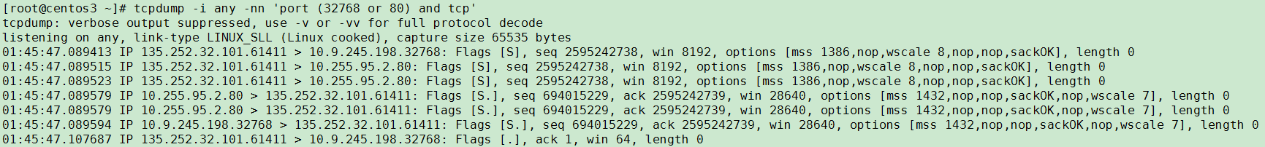
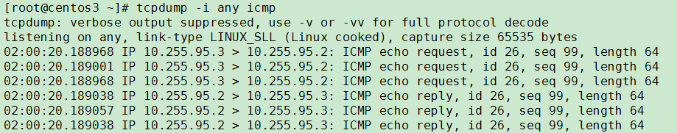
Bridge Mode Example Nginx publics port to host: package routing with tcpdump
Package route: eth0=docker0=vethxxx, # tcpdump -i any -nn 'port (32768 or 80) and tcp‘
One container pings another container, vethxxx=docker0=vethyyy, # tcpdump -i any icmp
Notes:
http://dockone.io/article/1521

Slide 9
Docker Network: host mode
Docker host: 10.13.245.198
-net=host
Docker container and host share a same network namespace. (no CLONE_NEWNET flag when create docker sub process)
More efficient
Less secure
Container: host mode
lo
eth0
10.13.245.198
Notes:
容器启动时和宿主机公用网络配置
使用宿主机的地址作为容器地址
端口也为宿主机的端口，但不能使用低配置端口，需要管理好端口分配
网络没有进行隔离，存在安全隐患

Slide 10
Docker Network: other container mode
Docker host: 10.13.245.198
-net=container: name or id
These two docker containers share a same network namespace. And use localhost to access another container resource.
Kubernetes pod containers
Container: container mode
Container: bridge mode
lo
eth0
10.255.95.2
10.255.95.2
eth0
Notes:
启动容器时和另外一个容器共用网络配置
使用另外一个容器的地址作为容器地址
端口也为另外一个容器的端口，需要管理好端口分配
网络和另外一个容器没有进行隔离

Slide 11
Docker Network: none mode
Docker host: 10.13.245.198
-net=none
Docker container has no network stack.
Nova-docker
Container: none mode
No network stack
lo
Notes:
容器启动时不创建任何网络，即此时在容器内部没有配置任何地址
此模式可以在容器启动后再配置容器网络
网络创建的责任完全交给用户
Nova-docker使用此种方式

Slide 12
Docker Multi-host Network
Docker原生的Bridge模型：NAT机制导致无法使用容器IP进行跨服务器通讯. However, there are port mapping method, but the used IP address is not the container IP.
Docker原生的Host模型：大家都使用和服务器相同的IP，端口冲突问题很麻烦
Flannel (overlay)
Pipework (bridge)
OpenVSwitch (overlay)
Weave (overlay)
Calico (user space overlay)
Docker 1.9 libnetwork, require Linux kernel 3.6
VPP?

Slide 13
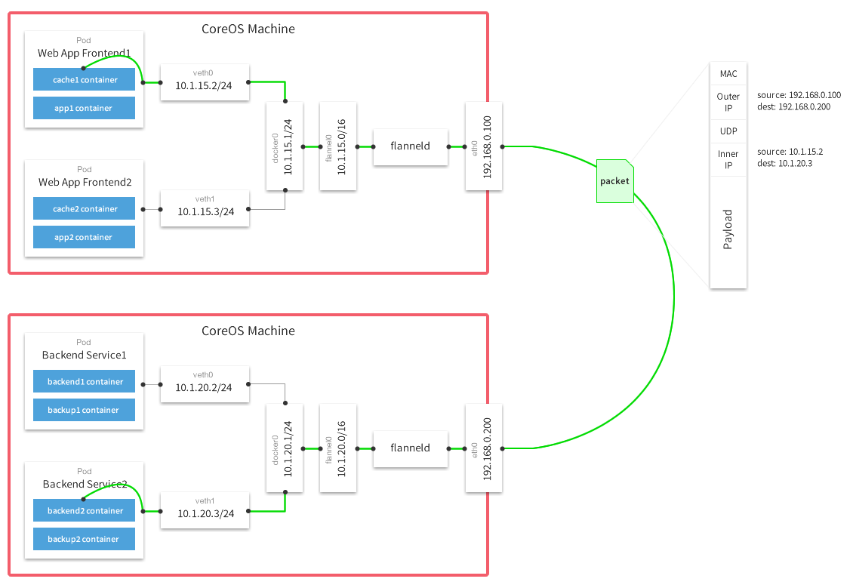
Flannel (Flannel + UDP or Flannel + VxLAN)
每个主机上安装并运行etcd和flannel
在etcd中规划配置所有主机的docker0子网范围
每个主机上的flanneld根据etcd中的配置，为本主机的docker0分配子网，保证所有主机上的docker0网段不重复，并将结果（即本主机上的docker0子网信息和本主机IP的对应关系）存入etcd库中，这样etcd库中就保存了所有主机上的docker子网信息和本主机IP的对应关系；
当需要与其他主机上的容器进行通信时，查找etcd数据库，找到目的容器的子网所对应的outip（目的宿主机的IP）；
将原始数据包封装在VxLAN或UDP数据包中，IP层以outip为目的IP进行封装, Port 8285 for UDP, 8472 for VxLAN；
由于目的IP是宿主机IP，因此路由是可达的；
VxLAN或UDP数据包到达目的宿主机解封装，解出原始数据包，最终到达目的容器。
Ether/IP/UDP(8285)/Payload(IP/…)
Ether/IP/UDP(8472)/VxLan/Payload(Ether/IP/…)
Notes:
Flannel是CoreOS团队针对Kubernetes设计的一个网络规划服务，简单来说，它的功能是让集群中的不同节点主机创建的Docker容器都具有全集群唯一的虚拟IP地址。
Flannel通过Etcd服务维护了一张节点间的路由表

Slide 14
Kubernetes Network: Flannel Network Configuration
Master
KUBE_SERVICE_ADDRESSES="--service-cluster-ip-range=10.254.0.0/16“
FLANNEL_ETCD_PREFIX="/k8s/network"
FLANNEL_OPTIONS="--iface=eth0"
Master: 10.9.245.200(eth0), 10.255.51.0/16(flannel0)
KUBE_SERVICE_ADDRESSES="--service-cluster-ip-range=10.254.0.0/16“
FLANNEL_ETCD_PREFIX="/k8s/network“ # flannel network
FLANNEL_OPTIONS="--iface=eth0“
# etcdctl set /k8s/network/config '{"Network": "10.255.0.0/16"}‘
Node1: 10.9.245.194(eth0), 10.255.61.0/16(flannel0)
10.255.61.1/24(docker0)
Node2: 10.9.245.198(eth0), 10.255.95.0/16(flannel0)
10.255.95.1/24(docker0)
Myservice
Pod 1: 10.255.61.13
Logserver
Pod 1: 10.255.95.2
Myservice
Pod 2:10.255.95.3
Notes:
'{"Network":"10.255.0.0/16","SubnetLen":24,"Backend":{"Type":"vxlan","VNI":1}} '
/etc/kubernetes/apiserver
# etcdctl set /k8s/network/config '{"Network": "10.255.0.0/16"}'
# etcdctl ls /k8s/network -r
/k8s/network/config # {"Network": "10.255.0.0/16"}
/k8s/network/subnets
/k8s/network/subnets/10.255.95.0-24 # {"PublicIP":"10.9.245.198"}
/k8s/network/subnets/10.255.61.0-24 # {"PublicIP":"10.9.245.194"}
/k8s/network/subnets/10.255.51.0-24 # {"PublicIP":"10.9.245.200"}

Slide 15
Kubernetes Network
Node network: host ip
master 10.9.245.200, node1 10.9.245.194, node2 10.9.245.200
Service network: service ip, cluster ip
used for services, virtual IP address, 10.254.0.0/16
Flannel network: pod ip = container ip, flannel ip
used for pods, 10.255.0.0/16, include flannel0 and docker0 in work nodes.
Pod是Kubernetes调度的基本unit。Pod内的多个container共享一个network namespace。 kubernetes在创建Pod时，首先先创建pause容器，然后再以pause的network namespace为基础，创建pod内的其他容器（–net=container:xxx），这样Pod内的所有容器便共享一个network namespace，这些容器间的访问直接通过localhost即可。比如Pod下A容器启动了一个服务，监听8080端口，那么同一个Pod下面的另 外一个B容器通过访问localhost:8080即可访问到A容器下面的那个服务。

Slide 16
Example: Show IP
[master]# kubectl get pods -o wide
NAME READY STATUS RESTARTS AGE IP NODE
logserver-ff9r1 1/1 Running 0 18s 10.255.95.2 node2
myservice-3jpzv 1/1 Running 0 18s 10.255.95.3 node2
myservice-z3pqw 1/1 Running 0 18s 10.255.61.13 node1
[master]# kubectl get service -o wide
NAME CLUSTER-IP EXTERNAL-IP PORT(S) AGE SELECTOR
logserver-log 10.254.100.171 <none> 8484/UDP 4m app=logserver
myservice 10.254.183.118 <nodes> 5252:30004/UDP 4m app=myservice
[master]# kubectl describe service myservice
Name: myservice
Namespace: default
Labels: <none>
Selector: app=myservice
Type: NodePort
IP: 10.254.183.118
Port: <unset> 5252/UDP
NodePort: <unset> 30004/UDP
Endpoints: 10.255.95.3:5252,10.255.61.13:5252
Session Affinity: None

Slide 17
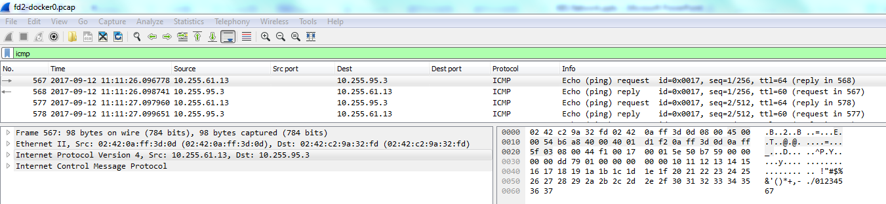
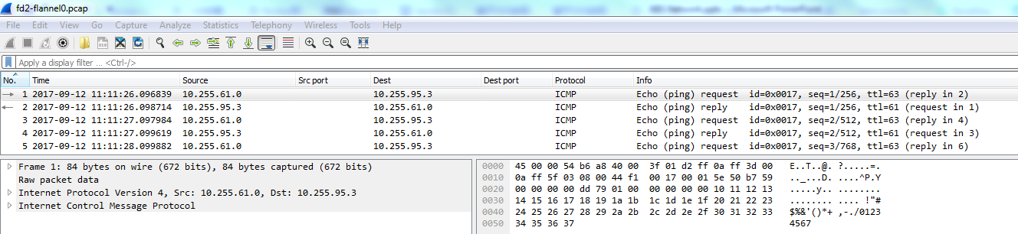

Kubernetes Example 1: Container 10.255.61.13 pings 10.255.95.3 (UDP Encapsulation)
[node1]# tcpdump -i docker0 -w fd-docker0.pcap
Ethernet II, Src: 02:42:0a:ff:3d:0d (container), Dst: 02:42:c2:9a:32:fd (docker0)
Internet Protocol Version 4, Src: 10.255.61.13, Dst: 10.255.95.3
[node1]> route -n
Kernel IP routing table
Destination Gateway Genmask Flags Metric Ref Use Iface
0.0.0.0 10.9.245.222 0.0.0.0 UG 0 0 0 eth0
10.9.245.192 0.0.0.0 255.255.255.224 U 0 0 0 eth0
10.255.0.0 0.0.0.0 255.255.0.0 U 0 0 0 flannel.1
10.255.47.0 0.0.0.0 255.255.255.0 U 0 0 0 docker0
[node1]# tcpdump -i flannel0 -w fd-flannel0.pcap
Internet Protocol Version 4, Src: 10.255.61.0, Dst: 10.255.95.3
How to understand the Src IP?

Slide 18
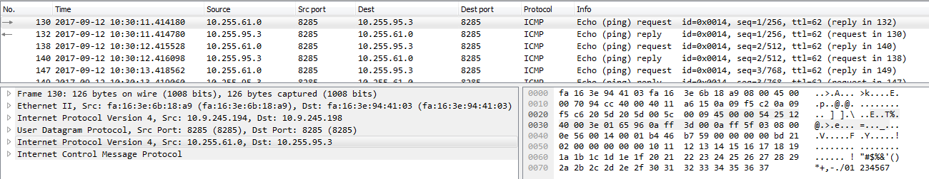
Kubernetes Example 1: Container 10.255.61.13 pings 10.255.95.3 (UDP Encapsulation)
[node2]# tcpdump -i eth0 -w fd-eth0.pcap
Ether/IP(src=10.9.245.194, dst=10.9.245.198)/UDP(sport=8285, dport=8285)/
IP(src=10.255.61.0(flannel0), dst=10.255.95.3(container IP))/ICMP()

Slide 19
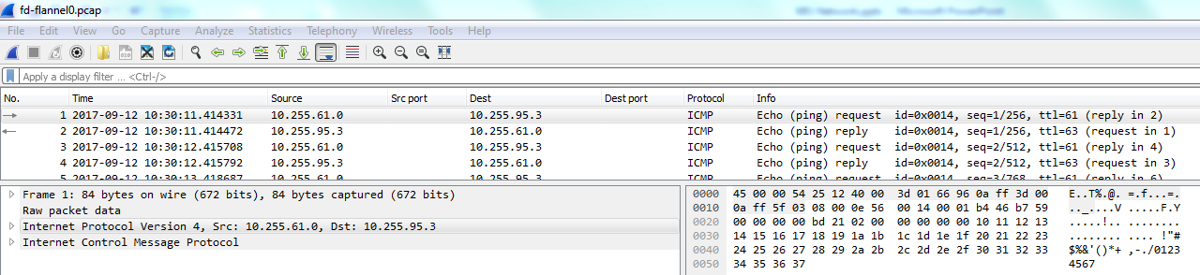
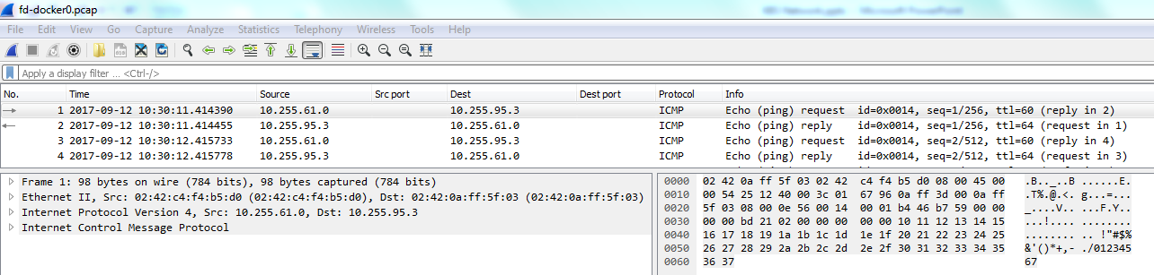
Kubernetes Example 1: Container 10.255.61.13 pings 10.255.95.3 (UDP Encapsulation)
[node2]# tcpdump -i flannel0 -w fd-flannel0.pcap
Ether/IP(src=10.9.245.194, dst=10.9.245.198)/UDP(sport=8285, dport=8285)/
IP(src=10.255.61.0(flannel0), dst=10.255.95.3(container IP))/ICMP()
[node2]> route -n
Kernel IP routing table
Destination Gateway Genmask Flags Metric Ref Use Iface
0.0.0.0 10.9.245.222 0.0.0.0 UG 100 0 0 eth0
10.9.245.192 0.0.0.0 255.255.255.224 U 0 0 0 eth0
10.255.0.0 0.0.0.0 255.255.0.0 U 0 0 0 flannel.1
10.255.95.0 0.0.0.0 255.255.255.0 U 0 0 0 docker0
[node2]# tcpdump -i docker0 -w fd-docker0.pcap
Ether/IP(src=10.9.245.194, dst=10.9.245.198)/UDP(sport=8285, dport=8285)/
Ether(src=02:42:c4:f4:b5:d0(docker0), dst=02:42:0a:ff:5f:03(container mac))
IP(src=10.255.61.0(flannel0), dst=10.255.95.3(container IP))/ICMP()

Slide 20
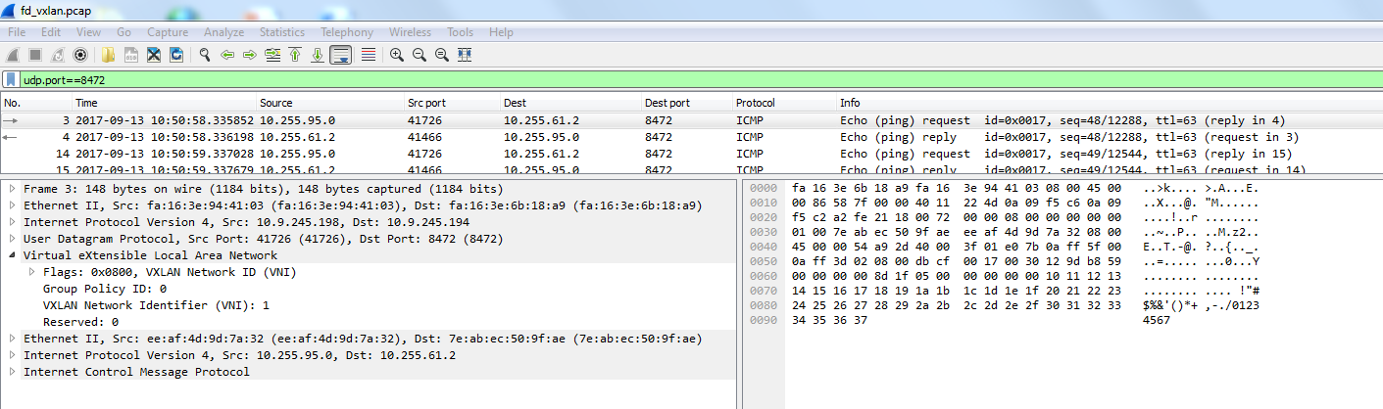
Kubernetes Example 1: Container 10.255.61.13 pings 10.255.95.3 (VxLan Encapsulation)
[node2]# tcpdump -i eth0 -w fd-eth0.pcap
Ether/IP(src=10.9.245.198, dst=10.9.245.194)/UDP(sport=8472, dport=8472)/
VxLan/Ether/IP(src=10.255.95.0(flannel0), dst=10.255.61.2(container IP))/ICMP()

Slide 21
Kubernetes Example 2: NodePort type Service Use NAT to implement load balance
# kubectl get service myservice
NAME CLUSTER-IP EXTERNAL-IP PORT(S) AGE
myservice 10.254.79.194 <nodes> 5252:30004/UDP 7m
# kubectl describe service myservice
Name: myservice
Namespace: default
Labels: <none>
Selector: app=myservice
Type: NodePort
IP: 10.254.79.194
Port: <unset> 5252/UDP
NodePort: <unset> 30004/UDP
Endpoints: 10.255.47.2:5252,10.255.95.6:5252
Session Affinity: None
K8S service myservice cluster IP is 10.254.79.194.
It exposes inside the K8S cluster on port 5252, and externally on NodePort 30004.
Traffic to this Service is balanced to two PODs:
10.255.47.2:5252 (on node1)
10.255.95.6:5252 (on node2)
K8S uses NAT to implement this.
# kubectl get pods -o wide
NAME READY STATUS RESTARTS AGE IP NODE
myservice-1k8cg 1/1 Running 0 3m 10.255.95.6 node2
myservice-2j1ww 1/1 Running 0 3m 10.255.47.2 node1

Slide 22
Kubernetes Example 2: NodePort type Service Use NAT to implement load balance
# iptables rule and select pod in local node
-A KUBE-SEP-CHNQ2ATUBBIDQE52 -p udp -m comment --comment "default/myservice:" -m udp -j DNAT --to-destination 10.255.95.6:5252
# find routing and forward this package to docker0
10.255.95.0/24 dev docker0 proto kernel scope link src 10.255.95.1
# nc –u 10.9.245.198 30004 hello
ip(10.9.245.198)/udp/hello
ip(10.255.95.6)/udp/hello
eth0
PREROUTING
DNAT
docker0
ip(10.255.47.2)/udp/hello
# iptables rule and select pod in other node
-A KUBE-SEP-BDBYPCY2DMZQVNR6 -p udp -m comment --comment "default/myservice:" -m udp -j DNAT --to-destination 10.255.47.2:5252
# forward this package to flannel.1
10.255.0.0/16 dev flannel.1
flannel.1
ip(10.9.245.194)/udp/ether/ip(10.255.47.2)/udp/hello
[node2]# ip -d link show flannel.1
6: flannel.1: <BROADCAST,MULTICAST,UP,LOWER_UP> mtu 1450 qdisc noqueue state UNKNOWN mode DEFAULT
link/ether da:72:a3:a3:2b:52 brd ff:ff:ff:ff:ff:ff promiscuity 0
vxlan id 1 local 10.9.245.198 dev eth0 srcport 0 0 dstport 8472 nolearning ageing 300 addrgenmode none
eth0

Slide 23
Kubernetes Example 2: NodePort type Service Use NAT to implement load balance
[all nodes]> lsof -i :30004
COMMAND PID USER FD TYPE DEVICE SIZE/OFF NODE NAME
kube-prox 923 root 10u IPv6 20158 0t0 UDP *:30004
[node2]> iptables on all worker nodes
# all traffic incoming to port 30004(outside) or 10.254.79.194:5252(inside) redirect to KUBE-SVC-DSD7SUFVG6QDBIXR chain (not Docker chain)
-A PREROUTING -m comment --comment "kubernetes service portals" -j KUBE-SERVICES
-A KUBE-SERVICES -d 10.254.79.194/32 -p udp -m comment --comment "default/myservice: cluster IP" -m udp --dport 5252 -j KUBE-SVC-DSD7SUFVG6QDBIXR
-A KUBE-SERVICES -m comment --comment "kubernetes service nodeports; NOTE: …" -m addrtype --dst-type LOCAL -j KUBE-NODEPORTS
-A KUBE-NODEPORTS -p udp -m comment --comment "default/myservice:" -m udp --dport 30004 -j KUBE-SVC-DSD7SUFVG6QDBIXR
# Set mark for return traffic doing SNAT
-A KUBE-NODEPORTS -p udp -m comment --comment "default/myservice:" -m udp --dport 30004 -j KUBE-MARK-MASQ
-A KUBE-MARK-MASQ -j MARK --set-xmark 0x4000/0x4000
# 50% of traffic send to KUBE-SEP-BDBYPCY2DMZQVNR6, the rest to KUBE-SEP-CHNQ2ATUBBIDQE52
-A KUBE-SVC-DSD7SUFVG6QDBIXR -m comment --comment "default/myservice:" -m statistic --mode random --probability 0.50000000000 -j KUBE-SEP-BDBYPCY2DMZQVNR6
-A KUBE-SVC-DSD7SUFVG6QDBIXR -m comment --comment "default/myservice:" -j KUBE-SEP-CHNQ2ATUBBIDQE52
-A KUBE-SEP-BDBYPCY2DMZQVNR6 -p udp -m comment --comment "default/myservice:" -m udp -j DNAT --to-destination 10.255.47.2:5252
-A KUBE-SEP-CHNQ2ATUBBIDQE52 -p udp -m comment --comment "default/myservice:" -m udp -j DNAT --to-destination 10.255.95.6:5252
----------------------------------------------------------------------------------------------------------------------------------------------------
# Do SNAT for marked traffic
-A POSTROUTING -m comment --comment "kubernetes postrouting rules" -j KUBE-POSTROUTING
-A KUBE-POSTROUTING -m comment --comment "kubernetes service traffic requiring SNAT" -m mark --mark 0x4000/0x4000 -j MASQUERADE
On accessing node2ip:30004, the dst IP will be NATed to pod IP:
If 10.255.95.6, redirect to docker0
Else 10.255.47.2, route to flannel.1. Flanneld will encapsulate this package, and redirect to node1.
For K8S service, you can use any node IP + published port to access it. (Whether or not there is a running pod in this node)
[node2]> route -n
Kernel IP routing table
Destination Gateway Genmask Flags Metric Ref Use Iface
0.0.0.0 10.9.245.222 0.0.0.0 UG 100 0 0 eth0
10.9.245.192 0.0.0.0 255.255.255.224 U 0 0 0 eth0
10.255.0.0 0.0.0.0 255.255.0.0 U 0 0 0 flannel.1
10.255.95.0 0.0.0.0 255.255.255.0 U 0 0 0 docker0

Slide 24
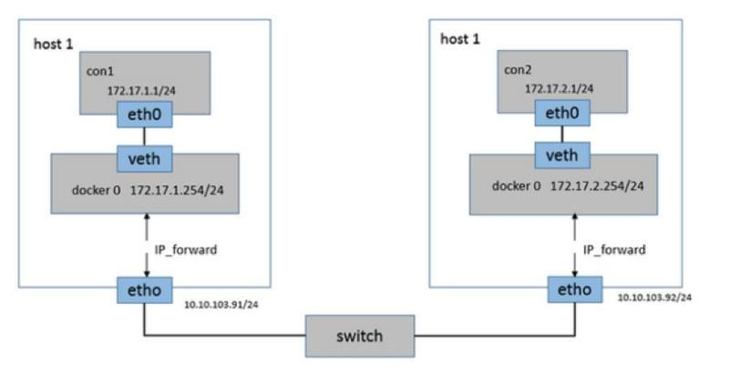
Static Routing (Direct Routing)
[host1]# ip route add -net 172.17.2.0/24 via 10.10.103.92 dev eth0
[host2]# ip route add -net 172.17.1.0/24 via 10.10.103.91 dev eth0
Notes:
http://www.cnblogs.com/yy-cxd/p/6553624.html
一分钟看懂Docker的网络模式和跨主机通信

Slide 25
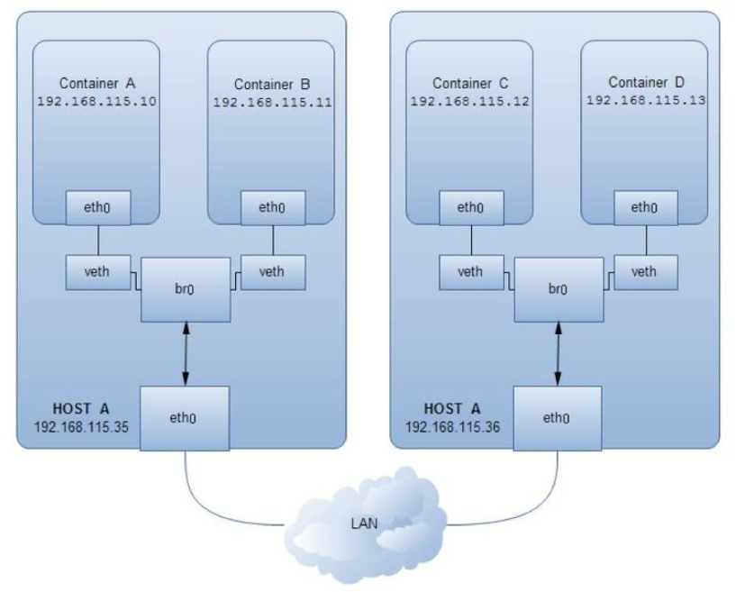
Pipework
使用新建的Linux bridge (br0)网桥代替缺省的docker0网桥
br0网桥与缺省的docker0网桥的区别：br0和主机eth0之间也是veth pair
Apply to:
将Docker容器配置到和主机同一网段的需求(linux bridge, shown as the left figure)
单主机Docker容器多VLAN划分(OVS)
多主机Docker容器多VLAN划分(OVS)
https://github.com/jpetazzo/pipework.git
http://www.infoq.com/cn/articles/docker-network-and-pipework-open-source-explanation-practice
Notes:
http://dockone.io/article/1521

Slide 26
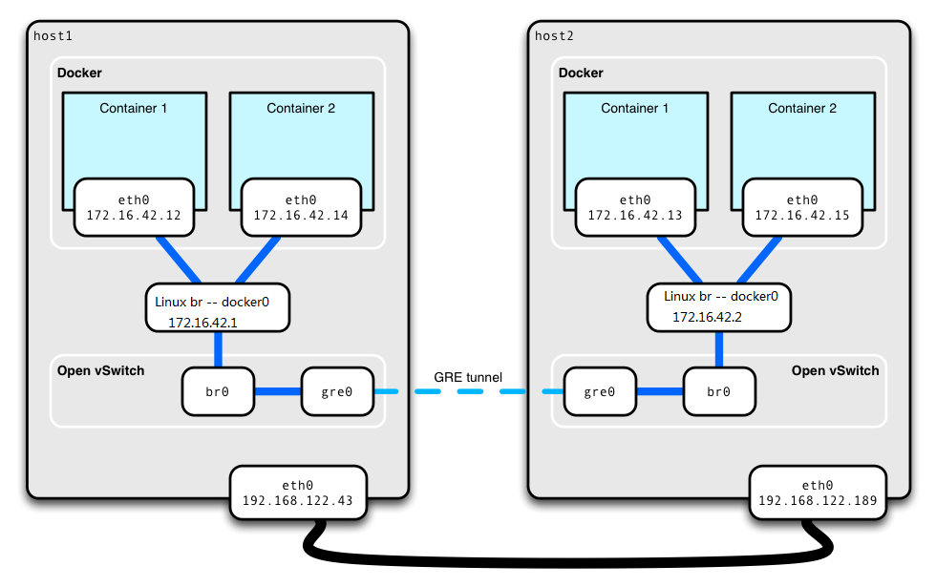
OpenVSwitch
Create a new ovs-br to replace the docker0
Add ovs port and interface (type is GRE or vxlan)
Set remote IP
// GRE type
ovs-vsctl add-port ovs-br0 gre0 -- set interface gre0 type=gre options:remote_ip=$REMOTE_IP
// vxlan type
ovs-vsctl add-port ovs-br0 vx0 -- set interface vx0 type=vxlan options:remote_ip=$REMOTE_IP
http://www.dockerinfo.net/1819.html
http://cloudgeekz.com/400/how-to-use-openvswitch-with-docker.html

Slide 27
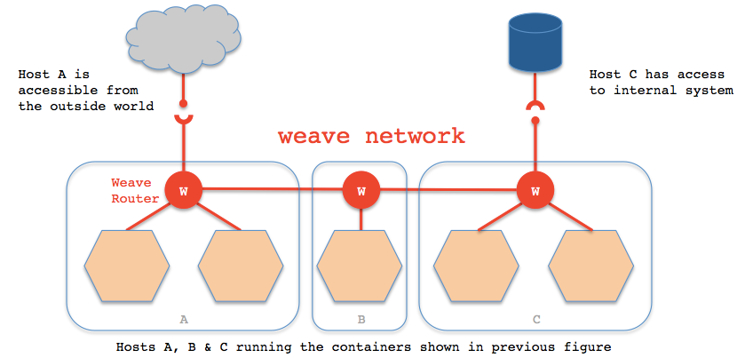
Weave
Weave creates a network bridge on the host.
Each container is connected to that bridge via a veth pair, the container side of which is given the IP address & netmask supplied in ‘weave run’. Also connected to the bridge is the weave router container.
A weave router captures Ethernet packets from its bridge-connected interface in promiscuous mode, using ‘pcap’.
Captured packets are forwarded over UDP to weave router peers running on other hosts.
On receipt of such a packet, a router injects the packet on its bridge interface using ‘pcap’ and/or forwards the packet to peers.
https://www.weave.works/
Notes:
http://dockone.io/article/1521

Slide 28
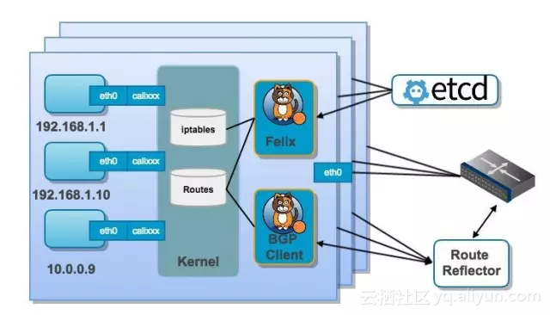
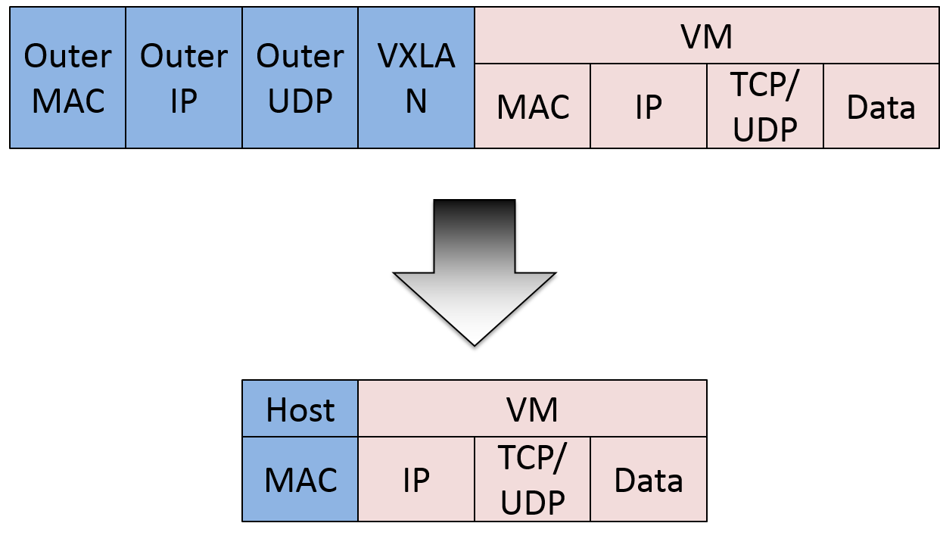
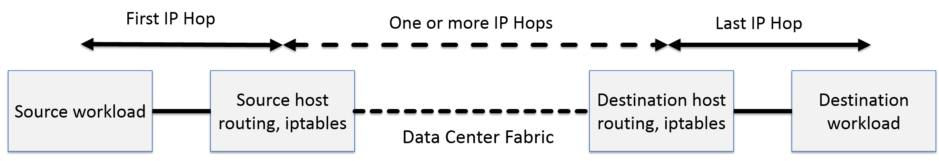
Calico
No overlay required.
No NAT required.
https://www.projectcalico.org/
https://docs.projectcalico.org/v2.0/getting-started/kubernetes/
Notes:
http://www.cnblogs.com/zhenyuyaodidiao/p/5322782.html
https://yq.aliyun.com/articles/68558?utm_campaign=wenzhang&utm_medium=article&utm_source=QQ-qun&utm_content=m_9247

Slide 29
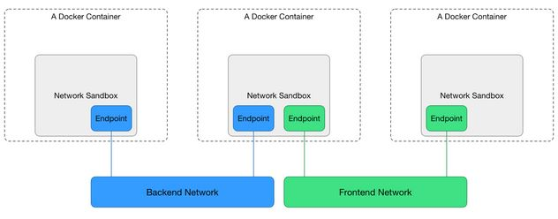
Docker libnetwork (from docker 1.9)
https://github.com/docker/libnetwork/blob/master/docs/design.md

Slide 30
Performance Test and Compare: Kubernetes Flannel/UDP Network
Tool: iperf
Item | Node(10.9.245.194-198) | Container(10.255.95.3-10.255.61.13)
Delay/ms | 0.47 | 1.30 | -176% ↓
Delay/ms(Flannel VxLan) | 0.47 | 0.67 | -42% ↓
Bandwidth/TCP | 15G | 450M | ↓
Bandwidth/UDP(100M) | 105Mbits/sec 0.001msjitter/0.0043lost | 99.8Mbit/sec 0.088jitter/0.12%lost
ping 10.9.245.198 | head -n 20 | gawk '/time/ {split($7, ss, "="); sum+=ss[2]; count+=1;} END{print sum/count "ms";}‘
Iperf -s -u
Iperf -c 10.9.245.198 -t 60 -u -b 100M
Notes:
https://wenku.baidu.com/view/64bbe2cb0408763231126edb6f1aff00bed57040.html

Slide 31
Performance Test and Compare
Tool: iperf
Network Mode | Delay | Bandwidth | Nginx(QPS/delay)
Bare Host | 0.244842ms | 942Mb/s | 12439.61/4.019
neutron | 0.747789ms | 907Mb/s | 9065.38/5.515
flannel vxlan | 0.727158ms | 910Mb/s | 10031.23/4.886
Calico | 0.267684ms | 941Mb/s | 10804.44/4.628
OVS vxlan | 0.35475ms | 917Mb/s | 11457.32/4.364
From http://blog.csdn.net/ptmozhu/article/details/54630952
Notes:
https://wenku.baidu.com/view/64bbe2cb0408763231126edb6f1aff00bed57040.html

Slide 32
Appendix 1: Linux Bridge: layer2, similar with switch
Brctl method( + /etc/sysconfig/network-script/ifcfg-* + restart network)
# brctl addbr br0
# brctl addif br0 eth0
# brctl br0 up
# ifconfig br0 192.168.20.20 netmask 255.255.255.0
Nmcli method (immediate effect)
# nmcli conn add con-name br0 type bridge ifname br0
# nmcli conn add con-name br0-port1 type bridge-slave ifname eth0 master br0
# nmcli conn modify br0 ipv4.address “192.168.20.20/24,192.168.20.1”
# nmcli conn modify br0 ipv4.method manual
lsmod | grep bridge
brctl show
Notes:
网桥是一个二层设备，工作在链路层，主要是根据MAC学习来转发数据到不同的port。

Slide 33
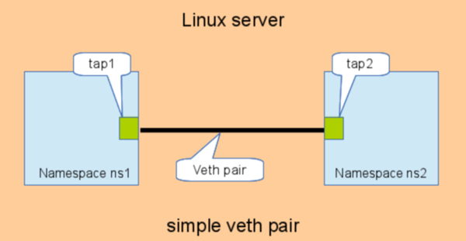
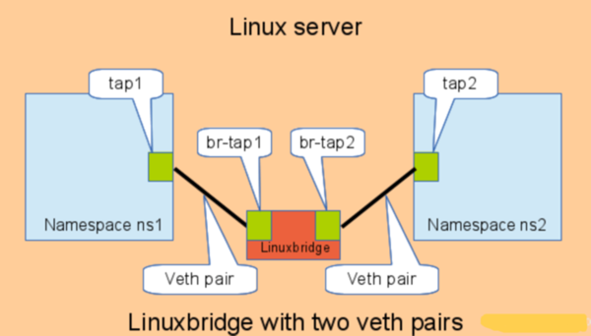
Appendix 2: Linux Veth Pair
# add the namespaces
ip netns add ns1
ip netns add ns2
# create the veth pair
ip link add tap1 type veth peer name tap2
# move the interfaces to the namespaces
ip link set tap1 netns ns1
ip link set tap2 netns ns2
# bring up the links
ip netns exec ns1 ip link set dev tap1 up
ip netns exec ns2 ip link set dev tap2 up
# enter namespace and show interface
ip netns exec ns1 bash
ifconfig // there is a only tap1 interface
ethtool -S tap1
NIC statistics:
peer_ifindex: 24
Notes:
http://www.cnblogs.com/hustcat/p/3928261.html
veth pair是一对虚拟网络设备，一端发送的数据会由另外一端接受，常用于不同的网络命名空间。

Slide 34
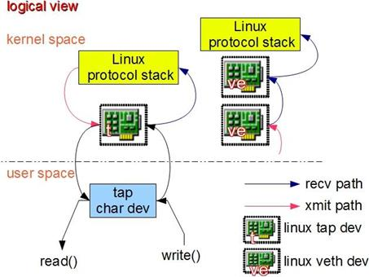
Appendix 3: Linux TUN/TAP
TUN (namely network TUNnel) simulates a network layer device and it operates with layer 3 packets like IP packets.
TAP (namely network tap) simulates a link layer device and it operates with layer 2 packets like Ethernet frames.
Packets sent by an operating system via a TUN/TAP device are delivered to a user-space program (instead of physical wire) which attaches itself to the device. A user-space program may also pass packets into a TUN/TAP device. In this case, the TUN/TAP device delivers (or “injects”) these packets to the operating-system network stack thus emulating their reception from an external source.
# modinfo tun
# ip tuntap add tun0 mode tun
# ip tuntap add tap0 mode tap
# ifconfig tun0 0.0.0.0 up
http://openvpn.sourceforge.net
http://vtun.sourceforge.net
http://backreference.org/2010/03/26/tuntap-interface-tutorial/
Notes:
TAP/TUN设备是一种让用户态程序向内核协议栈注入数据的设备，TAP等同于一个以太网设备，工作在二层；而TUN则是一个虚拟点对点设备，工作在三层
http://www.ibm.com/developerworks/cn/linux/l-tuntap/index.html?ca=dwcn-newsletter-linux
TUN/TAP provides packet reception and transmission for user space programs. It can be viewed as a simple Point-to-Point or Ethernet device, which instead of receiving packets from a physical media, receives them from user space program and instead of sending packets via physical media writes them to the user space program. When a program opens /dev/net/tun, driver creates and registers corresponding net device tunX or tapX. After a program closed above devices, driver will automatically delete tunXX or tapXX device and all routes corresponding to it.

Slide 35
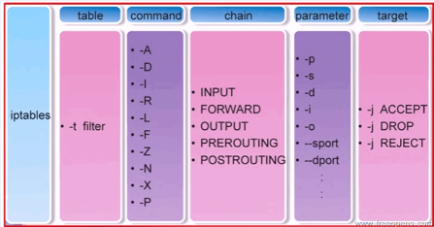
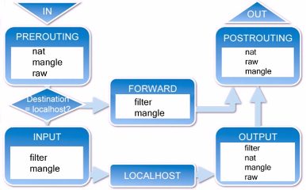
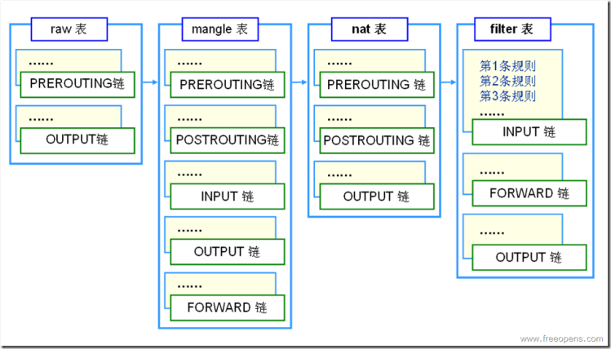
Appendix 4: Linux Iptables/Netfilter
https://linux.die.net/man/8/iptables
http://www.cnblogs.com/metoy/p/4320813.html
Notes:
5 hooks of netfilter are mapped with 5 default chains of iptables.
There are 4 tables: filter, nat, mangle and raw to provide the specific function.

Slide 36



